Slide 1
Daniel’s Law Now
Office of Information Privacy
CSI Technology Group

Slide 2
WHO IS COVERED BY DANIEL’S LAW?
Active, Formerly Active, and Retired Federal and State Judicial Officers, Prosecutors and Law Enforcement Officers, and their Immediate Family Members Residing with Them in the Same Household.
(N.J.S.A. 47:1b-1 et seq., P.L. 2021, c. 371)

Slide 3
Bills Pending
S 3125 ScaAca (2R)/A 4947
Would add Child Protective Investigators as CP’s
S 3363 SCA (1R)/A 4889
Would remove requirement that local gov’t officers disclose home address or principal residence on Financial Disclosure Statements

Slide 4
OIP: Portal for Covered Persons Opened 7/12/22 www.danielslaw.nj.gov
OIP 2-Step Vetting Process:
1. CP applies, using My NJ Account, with employment info and Pension #. OIP reviews and sends approval.
2. CP re-enters, provides residence information and names of household members to be redacted from government websites.

Slide 5
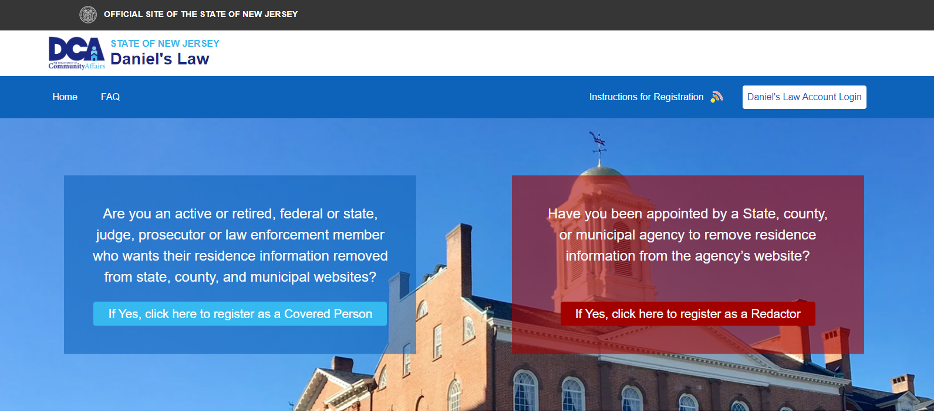
Daniel’s Law Now
Office of Information Privacy
CSI Technology Group

Slide 6
Covered Persons Can Register 24/7
If you have not yet registered for Daniel’s Law protections, go to:
www.danielslaw.nj.gov - BLUE SIDE!

Slide 7
By the Numbers: 8,000 Covered Persons have registered. Enrollment continues.

Slide 8
Are You A Redactor?
Redactors are appointed by their State, county, or municipal agency to remove the residence information of Covered Persons from the records the agency posts on its public-facing website. (Tax Assessors redact names!)

Slide 9
Redactors by the Numbers
1,800+ Registrations Received
8,000+ Redaction Requests Transmitted (x 5)

Slide 10
Redactors’ Qualifications
Suggestion: OPRA Custodians, Privacy Officers
Appoint multiple redactors based on type and depth of residential data your agency publicly posts.
Essential: Redactors must be respectful of the confidentiality of the data to be redacted, mindful of the need to preserve that confidentiality when they identify and redact it, and at all times in the future.

Slide 11
Redactors’ Roles and Responsibilities
Be familiar with the law - Review with agency counsel
Locate the residential data the agency posts
Determine your process for redactions
If you are appointed, register as a Redactor with the OIP and receive approval - Have a back up!
Return to the Portal for redaction notices and process them
Notify OIP when process is complete

Slide 12
Portal for Redactors Opened 1/12/23: danielslawredact.nj.gov
You can register with the OIP 24/7.
Register through the
RED SIDE!

Slide 13
Daniel’s Law Now
Office of Information Privacy
CSI Technology Group

Slide 14
View Redactor Demo: www.nj.gov/dca/oip/
View CSI’s demonstration of how to register as a redactor, receive notice of a redaction request, and notify OIP when redactions have occurred.

Slide 15
Next: If Appointed, Register!
If you’ve been appointed as a redactor by your State, county or local government agency, and you have not yet registered with the OIP, go to:
www.danielslawredact.nj.gov RED SIDE!

Slide 16
Troubleshooting
Once you move redaction notices from the “Approved Requests Pending Redaction” Inbox to the “Pending Confirmation” Inbox, you MUST move the notice out of that Inbox: i.e., either take steps to redact the information and record the redaction - or delete it. If you are not doing the actual redacting, delete the notice. Even if you are only monitoring redaction notices and your staff members are making redactions, you MUST move the notification out of your “Pending Confirmation” Inbox.

Slide 17
If you are no longer an appointed Redactor, advise the OIP.
OIP needs correct and correct data to assure it’s sending notices to the right person.

Slide 18
More Info for Redactors:
Office of Information Privacy: 609-815-3939
Email: Redactor.OIP@dca.nj.gov
Division of Elections: Lauren.Zyriek@sos.nj.gov;
Wade.Hall@sos.nj.gov; Brittany.Giampola@sos.nj.gov
Division of Taxation: taxation.propadminredact@treas.nj.gov
Local Govt Services (DCA): 609-913-4426

Slide 19
Thank you
Office of Information Privacy:
Christine Campbell, Director
Robert Feher, Regulatory Officer
CSI Technology Group:
Richard Norcross, Executive Vice President
Joshua Ottenberg, Director, County/State Agency Divisions
John Porter, Deputy Director, County/State Agency Divisions

