Slide 1
THE TAX COLLECTORS & TREASURERS ASSOCIATION OF NEW JERSEY CONFERENCE
The American Rescue Plan Act of 2021
Update
Tom Beckett, Managing Director tbeckett@nwfinancial.com
Heather Litzebauer, Managing Director
hlitzebauer@nwfinancial.com
Notes:
Use this title page...

Slide 2
THE AMERICAN RESCUE PLAN
$1.9 trillion stimulus bill passed in March 2021
$350 billion is dedicated to Coronavirus State and Local Fiscal Recovery Fund (SLFRF) for state and local governments
Funds have been fully disbursed to state and local governments
Final Rule governs the eligible uses, reporting requirements and timelines.
Recipients have ongoing Reporting responsibility including for sub-recipients.
Key Dates to remember:
Obligate (Encumber, Contract) Funds by December 31, 2024.
Spend Funds by December 31, 2026.
1

Slide 3
Managing ARP Funding - Checklist
Plan strategically to make effective use of the ARP funds
Develop, manage and maintain thorough recordkeeping
Review Revenue Loss calculation, if applicable
Keep records on eligibility approval
Monitor subrecipients
Submit required reports to Treasury
Avoid recoupment and penalties
Watch for updates from the Treasury Department
Monitor “Recission or Clawback” Legislation
Preliminary legislation with definitional issue
What is unobligated?
2

Slide 4
American Rescue Plan Act - Eligible Use Categories
Public Health
Negative Economic Impacts
Services to Disproportionately Impacted Communities
Revenue Replacement
Premium Pay
Infrastructure
Administrative and Other
3

Slide 5
Reporting – Reporting Deadlines
Must continue to report through 2026 even if funds are completely obligated and spent!
4

Slide 6
Reporting – Roles & Best Practices
Reporting Roles:
Account Administrator – maintains names and contact information
Point of Contact – receives notifications, may draft the reports
Authorized Representative for Reporting – certifies and submits reports
Reporting Best Practices
Transfer of Roles
Get the passwords
Stay in contact with the prior AA or AR might need their cell number for 2 factor authentication.
Monitor Sub-recipients
SAM.gov number
Specify reporting timelines in any grant agreement
5

Slide 7
Reporting – Submitting to DCA
From the Division of Community Affairs:
All Project and Expenditure Reports filed with U.S. Treasury, along with any Interim Reports and Recovery Plan and Performance Reports required from certain municipalities and counties, must be submitted in pdf format to LFRF.Reporting@dca.nj.gov.
Please include the name of your municipality or county, along with its assigned municode, in the subject heading. U.S. Treasury Comp
6

Slide 8
Selected Resources
Resources from the U.S. Treasury:
Final Rule: https://home.treasury.gov/system/files/136/SLFRF-Final-Rule.pdf
Webinar on Final Rule: https://home.treasury.gov/system/files/136/SLFRF-Final-Rule-Webinar.pdf
Overview of the Final Rule: https://home.treasury.gov/system/files/136/SLFRF-Final-Rule-Overview.pdf
Final Rule Frequently Asked Questions (as of 4/27/2022): https://home.treasury.gov/system/files/136/SLFRF-Final-Rule-FAQ.pdf
Recipient Compliance & Reporting Page: https://home.treasury.gov/policy-issues/coronavirus/assistance-for-state-local-and-tribal-governments/state-and-local-fiscal-recovery-funds/recipient-compliance-and-reporting-responsibilities
Project & Expenditure Report User Guide: https://home.treasury.gov/system/files/136/April-2022-PE-Report-User-Guide.pdf
Resources from others:
Government Finance Officers Association on ARPA Funds “Clawback” legislation: https://www.gfoa.org/member-alert-proposal-to-claw-back-unobligated-arpa
National League of Cities ARP Portal: https://www.nlc.org/covid-19-pandemic-response/american-rescue-plan-act/
Division of Local Government Services, Adopting the Final Rule: https://www.nj.gov/dca/divisions/dlgs/lfns/22/2022-07.pdf
Division of Local Government Services, Submitting Reports to DCA: https://www.nj.gov/dca/divisions/dlgs/lfns/22/2022-08.pdf
Getting help
With general questions about the SLFRF program: SLFRF@treasury.gov
With reporting: SLFRF@treasury.gov or call (844)-529-9527
With technical support: covidreliefitsupport@treasury.gov
From the National Association of Counties: questions@naco.org
From NW Financial Group: Heather Litzebauer at hlitzebauer@nwfinancial.com or Tom Beckett at tbeckett@nwfinancial.com
7

Slide 9
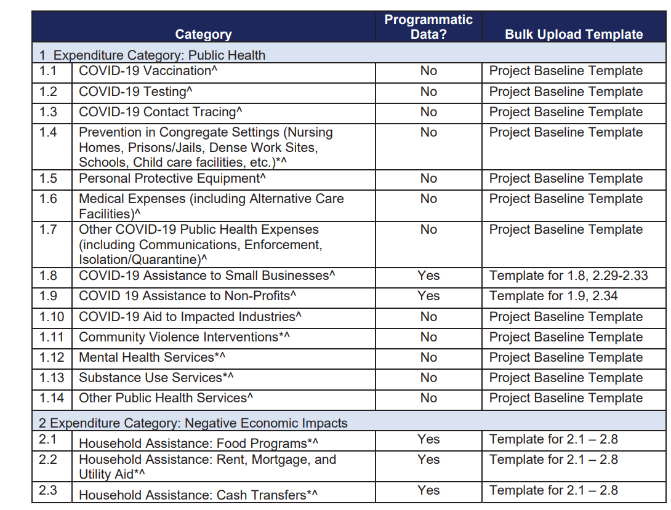
Expenditure Categories 1.1 to 2.3
8

Slide 10
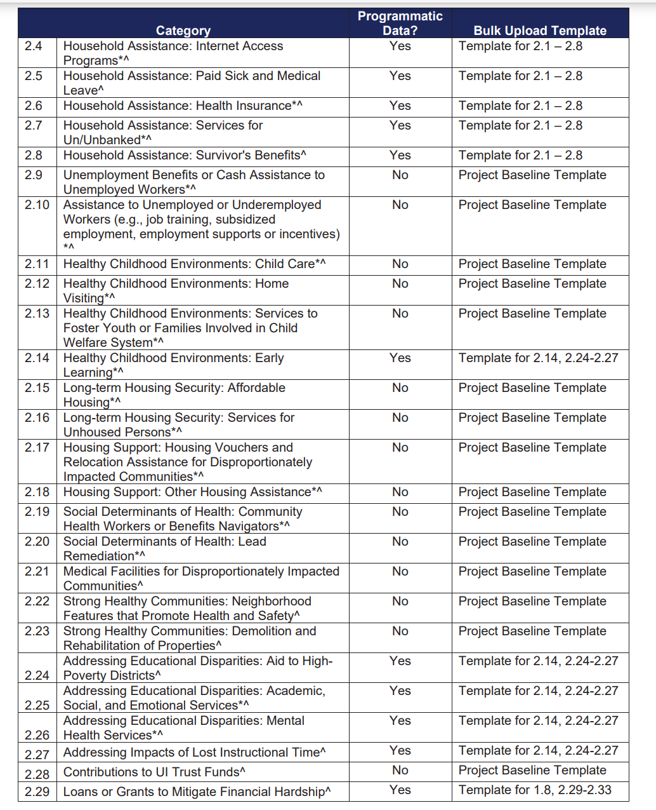
Expenditure Categories – 2.4 to 2.29
9

Slide 11
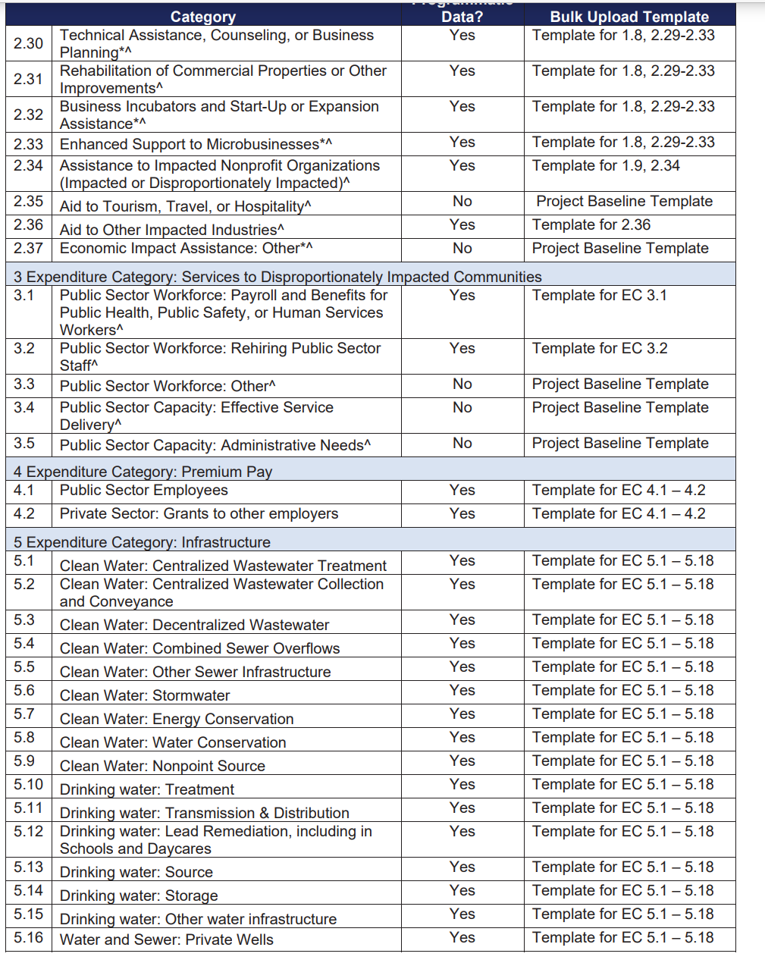
Expenditure Categories – 2.3 to 5.16
10

Slide 12
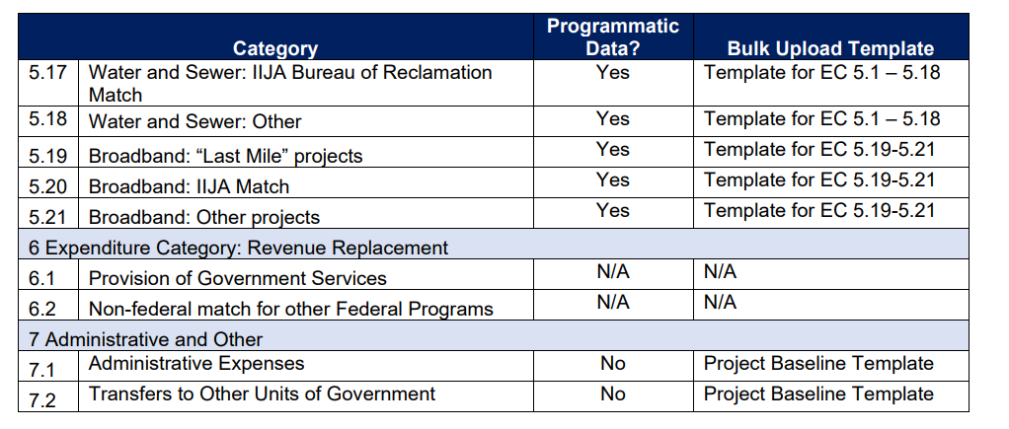
Expenditure Categories 5.17 to 7.2
11

Slide 13
Questions and Conversation
12

